Slide 1
The Age Of Enlightenment & The Protestant Reformation
John Wycliffe – English Reformer (1329-1384)
Teacher At Oxford University, England
Began Lollards, Followers Preaching His Reform Message
Graphic Source: Wikipedia.com
See More At http://www.TheRestorationMovement.com/

Slide 2
Teachings Of John Wycliffe
Graphic Source: Wikipedia.com
Graphic Source: Wikipedia.com
See More At http://www.TheRestorationMovement.com/

Slide 3
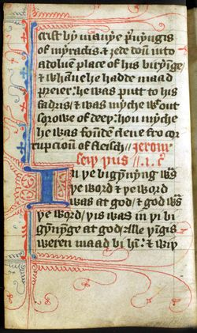
The Wycliffe Translation
Beginning of the Gospel of John from a 14th century copy of Wycliffe's translation.
See More At http://www.TheRestorationMovement.com/

Slide 4
Result Of Wycliffe’s Work
Graphic Source: Wikipedia.com
See More At http://www.TheRestorationMovement.com/

Slide 5
Jan Hus – 1373-1415 Prague, Bohemia (Czech Republic)
Graphic Source: Wikipedia.com
Bohemian Pastor Of Bethlehem Chapel
1409 Rector Of University Of Prague
1409 Directed National Bohemian Party – Calling For Reform
Was Excommunicated As Heretic At Council Of Constance
Graphic Source: Wikipedia.com
Statue Of Jan Hus, Prague
See More At http://www.TheRestorationMovement.com/

Slide 6
Girolamo Savonarola 1452-1498
Graphic Source: Wikipedia.com
See More At http://www.TheRestorationMovement.com/

Slide 7
Troubles Existing In The Roman Church
Simony
Indulgences
Unum Sanctum – 1302 A.D.
“Babylonian Captivity” Of Papacy in Avignon, France – 1309-1377 A.D.
See More At http://www.TheRestorationMovement.com/

Slide 8
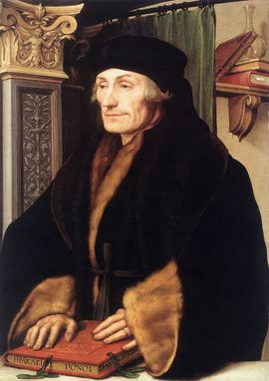
Planting The Seed Of Reform The Rise Of Knowledge: Humanism
Petrarch (1304-1374)
Desiderius Erasmus (1466-1536)
Thomas More (1478-1535) – English Author & Catholic Martyr
Ulrich von Hutten – (1488-1523) – German Patriot, Poet, Knight, Classical Scholar, Satirist
Johann Reuchlin (1455-1522) – German Humanist and Hebrew Scholar, Lexicographer
Graphic Source: Wikipedia.com
Erasmus 1466-1636
See More At http://www.TheRestorationMovement.com/

Slide 9
The Johannes Gutenberg Printing Press - 1454
Arguably History’s Greatest Invention
Produced In Mainz, Germany
First Produced Book: The Bible
Graphic Source: Wikipedia.com
See More At http://www.TheRestorationMovement.com/

Slide 10
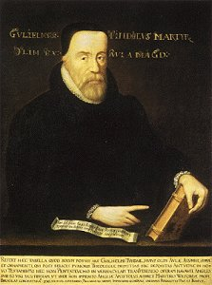
William Tyndale 1494-1536
Graphic Source: Wikipedia.com
Tyndale Version Of Bible
See More At http://www.TheRestorationMovement.com/

Slide 11
Other Bible Translation Particulars
In 1535 the Miles Coverdale work began, which was taken mostly from Wycliffe and Tyndale.
In 1557 the Bible was divided into chapters and verses.
By 1579 versions were so readily available that the average home was able to afford one.
The Bishop's Bible – 1586
1611 – The King James Bible
See More At http://www.TheRestorationMovement.com/

Slide 12
1500 – 1800 A.D.
Martin Luther 1483-1546

Slide 13
Ulrich Zwingli (1484-1531)

Slide 14
John Calvin 1509-1564

Slide 15
Reformation Among Catholics: Council Of Trent (1545-1563)

Slide 16
Peter Meiderlin (Rupertus Meldenius) (1582-1681)
“In Essentials, Unity; in Non-essentials, Liberty; in All Things, Charity” —1626

Slide 17
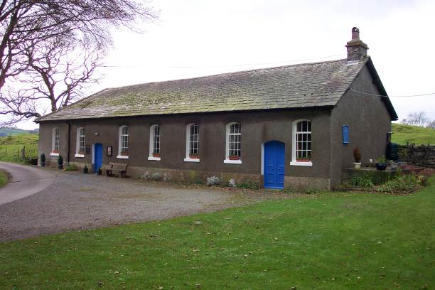
Tottlebank Church
A Church of Christ
-Early As 1669

Slide 18
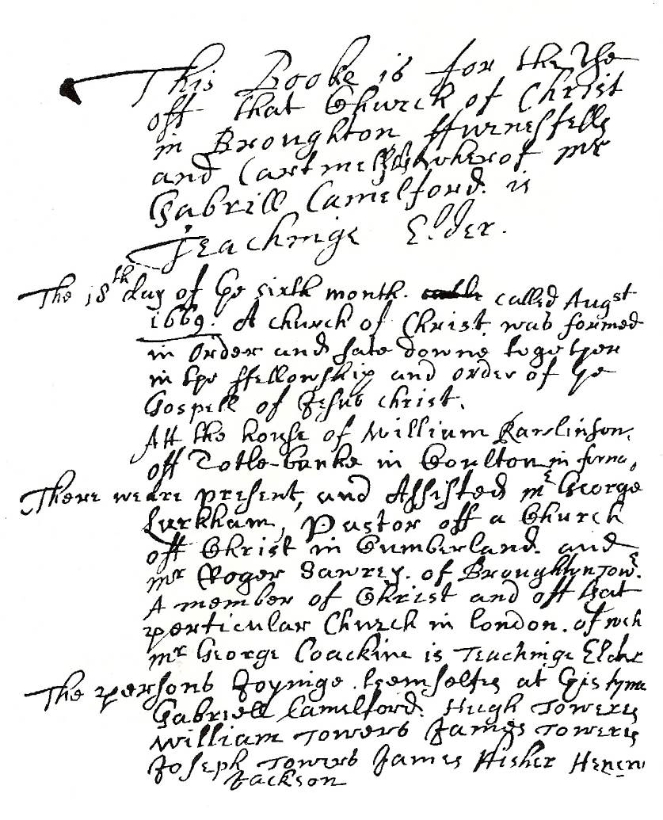
The Ledger
This booke is for the use of that Church of Christ in Broughton furnessfell and Cartmell whereof Mr. Gabrill Camelford is Teachinge Elder
The 18th day of ye sixth month called August 1669 A church of Christ was formed in order and sate down together in the fellowship and order of ye Gospel of Jesus Christ. Att the house of William Rawlinson off Totle-banke in Coulton in furness.

